Slide 1
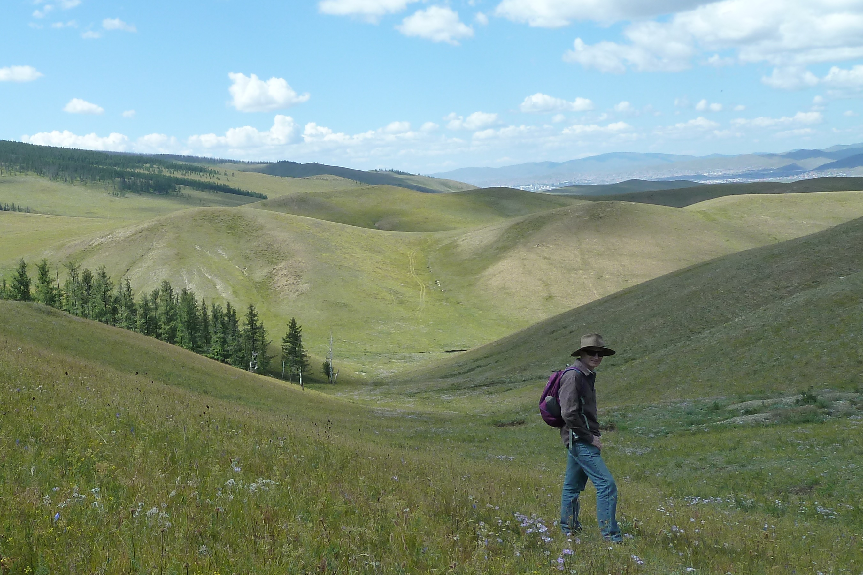
Mongolia is a huge country, the size of western Europe with the population of Wales

Slide 2
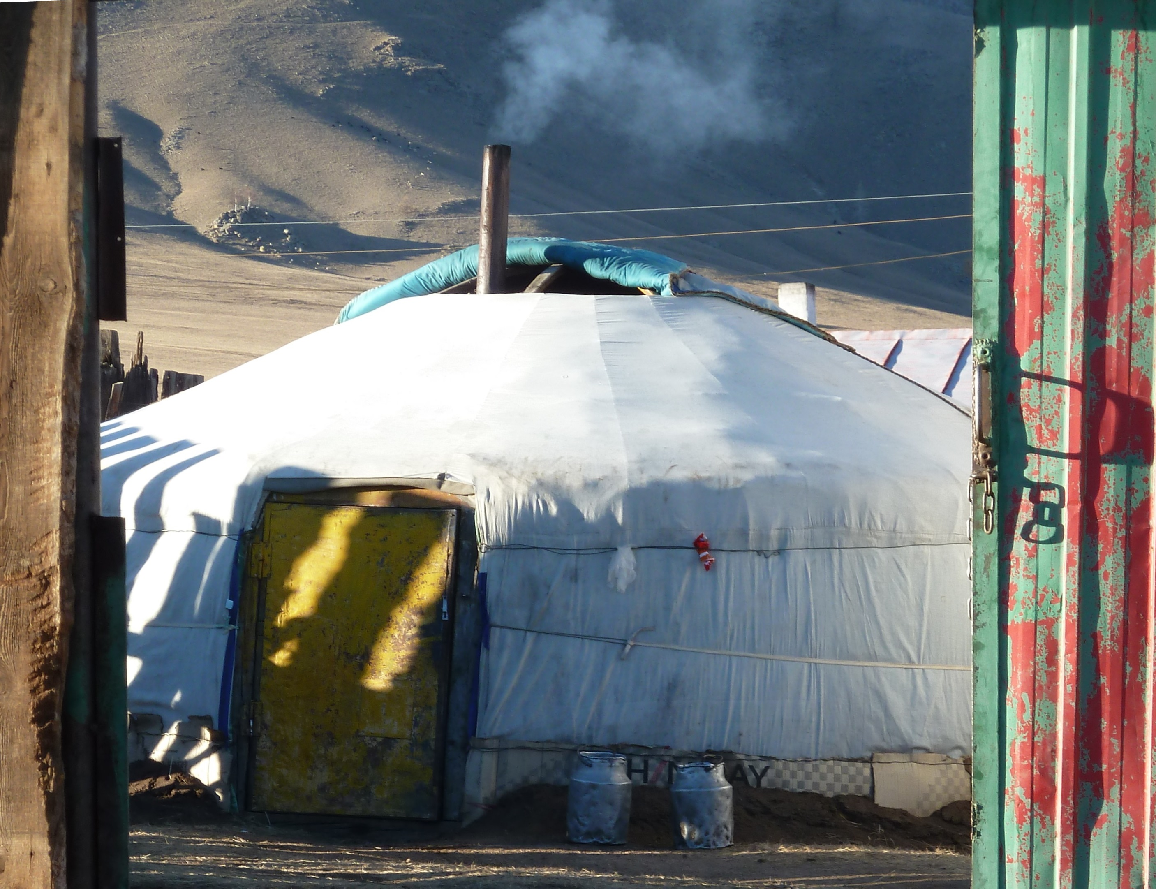
Many Mongolians live in a round tent called a ger

Slide 3
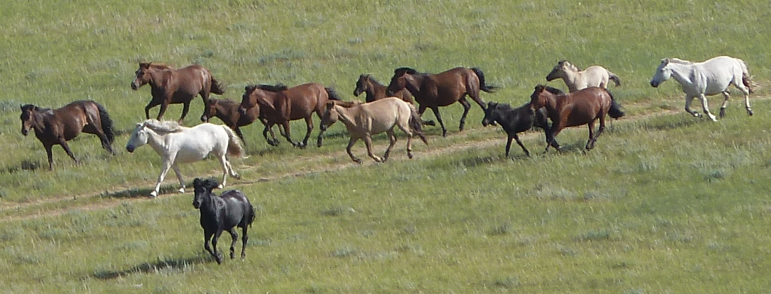
There are more horses than people
Countryside children learn to ride young

Slide 4
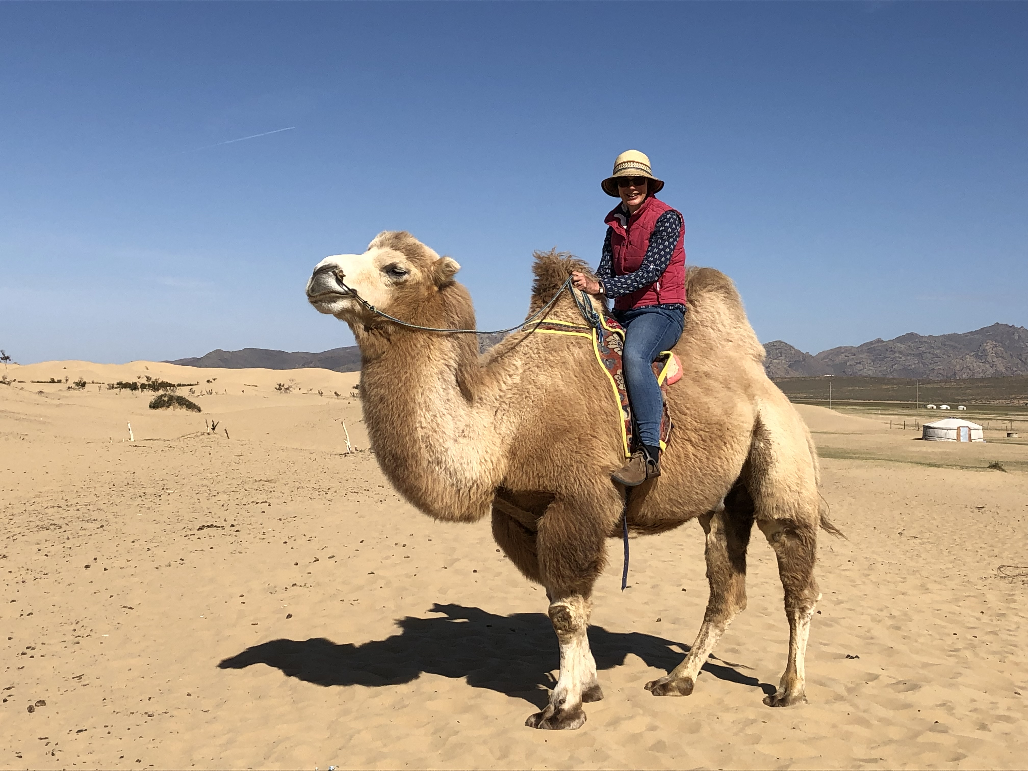
There are also lots of two-humped camels

Slide 5
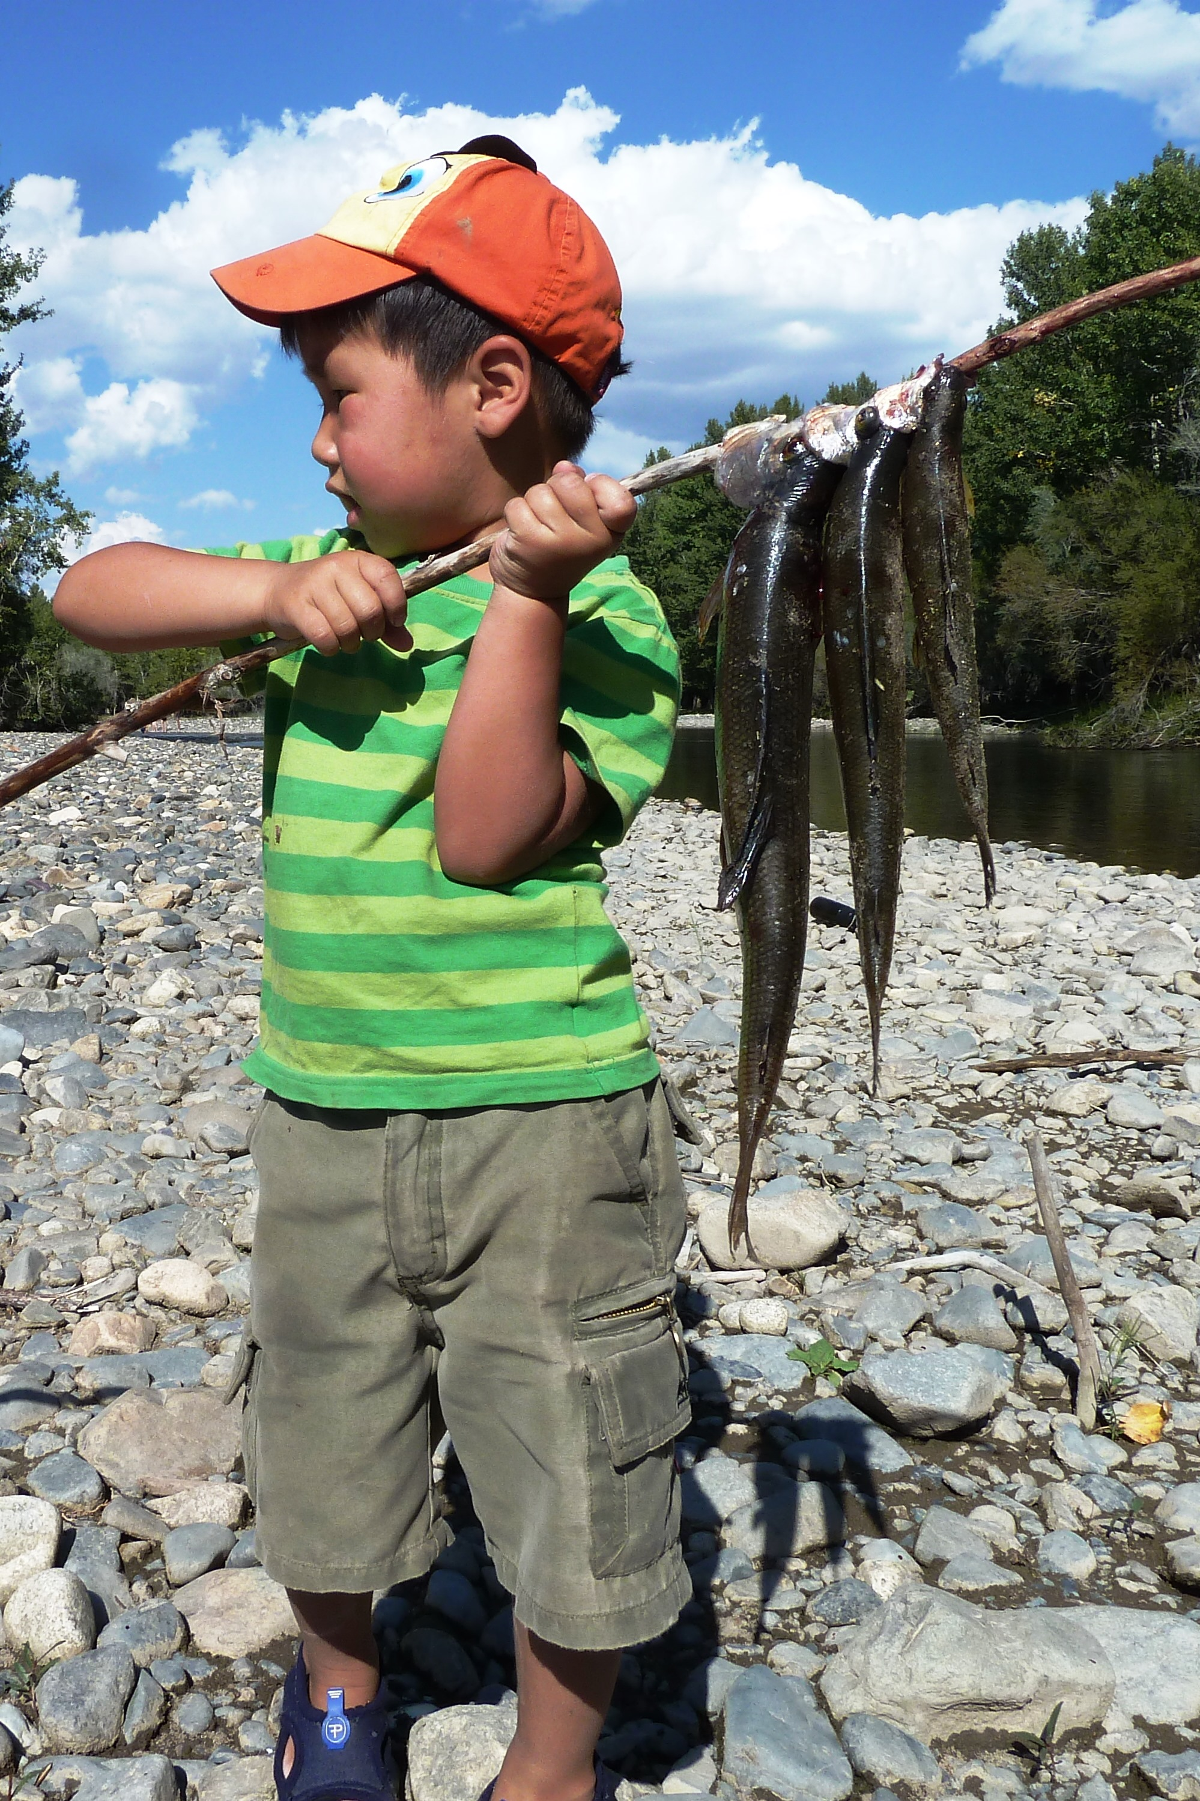
Mongolians love to eat meat, and they like to fish too. Here is a young fisherman

Slide 6
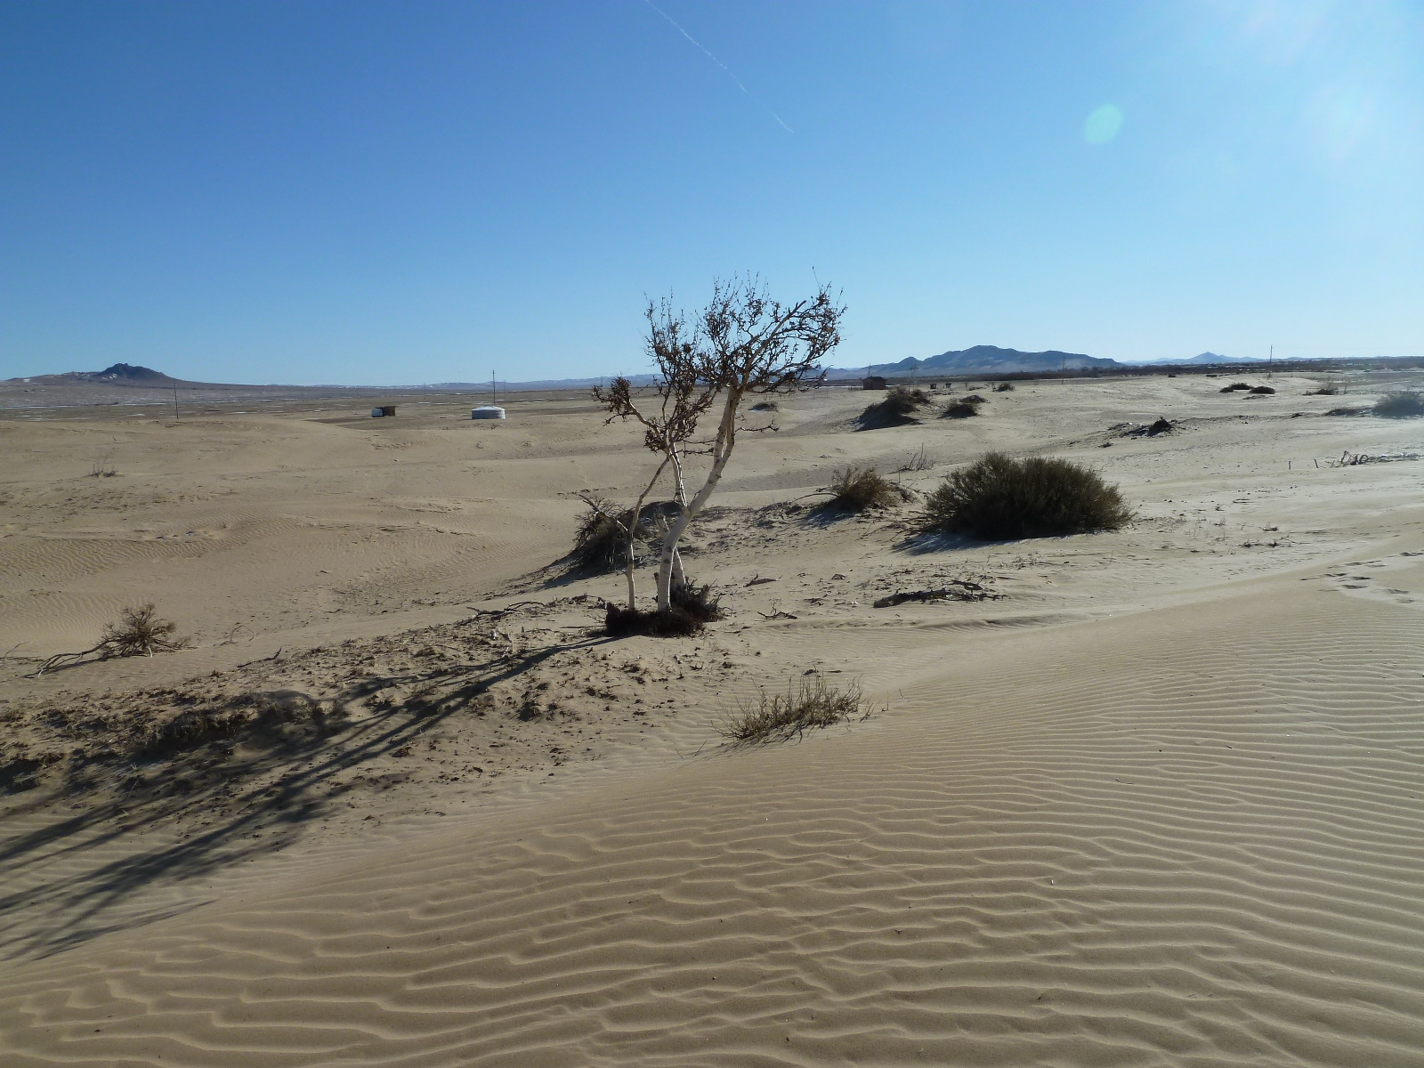
Part of Mongolia is the dry and dusty Gobi Desert

Slide 7
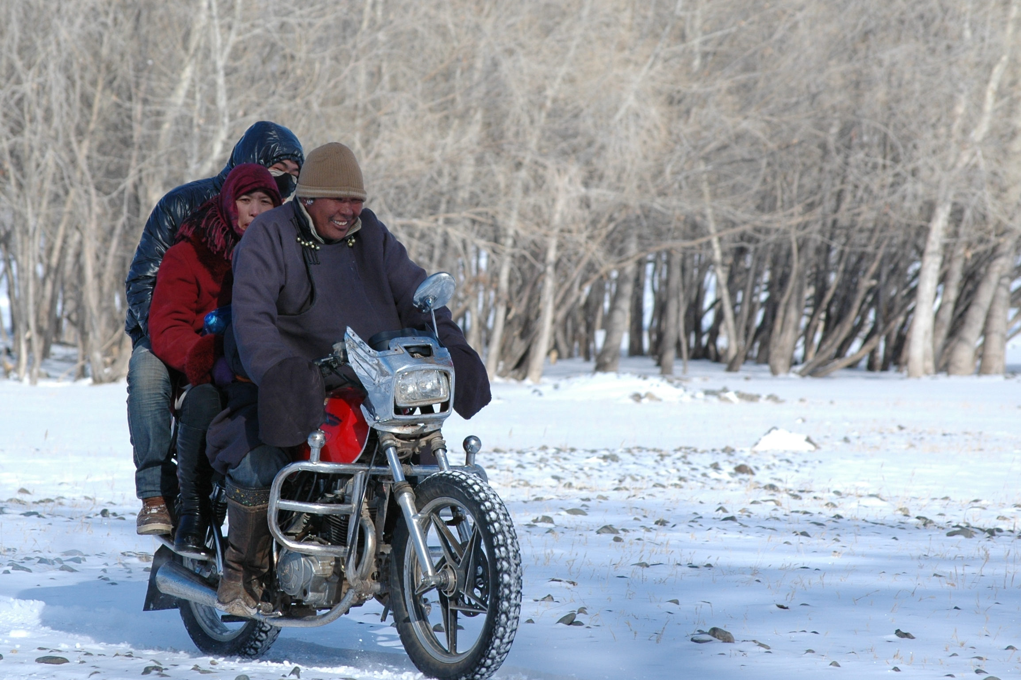
Winters are very cold, but this doesn’t stop people going outside

Slide 8
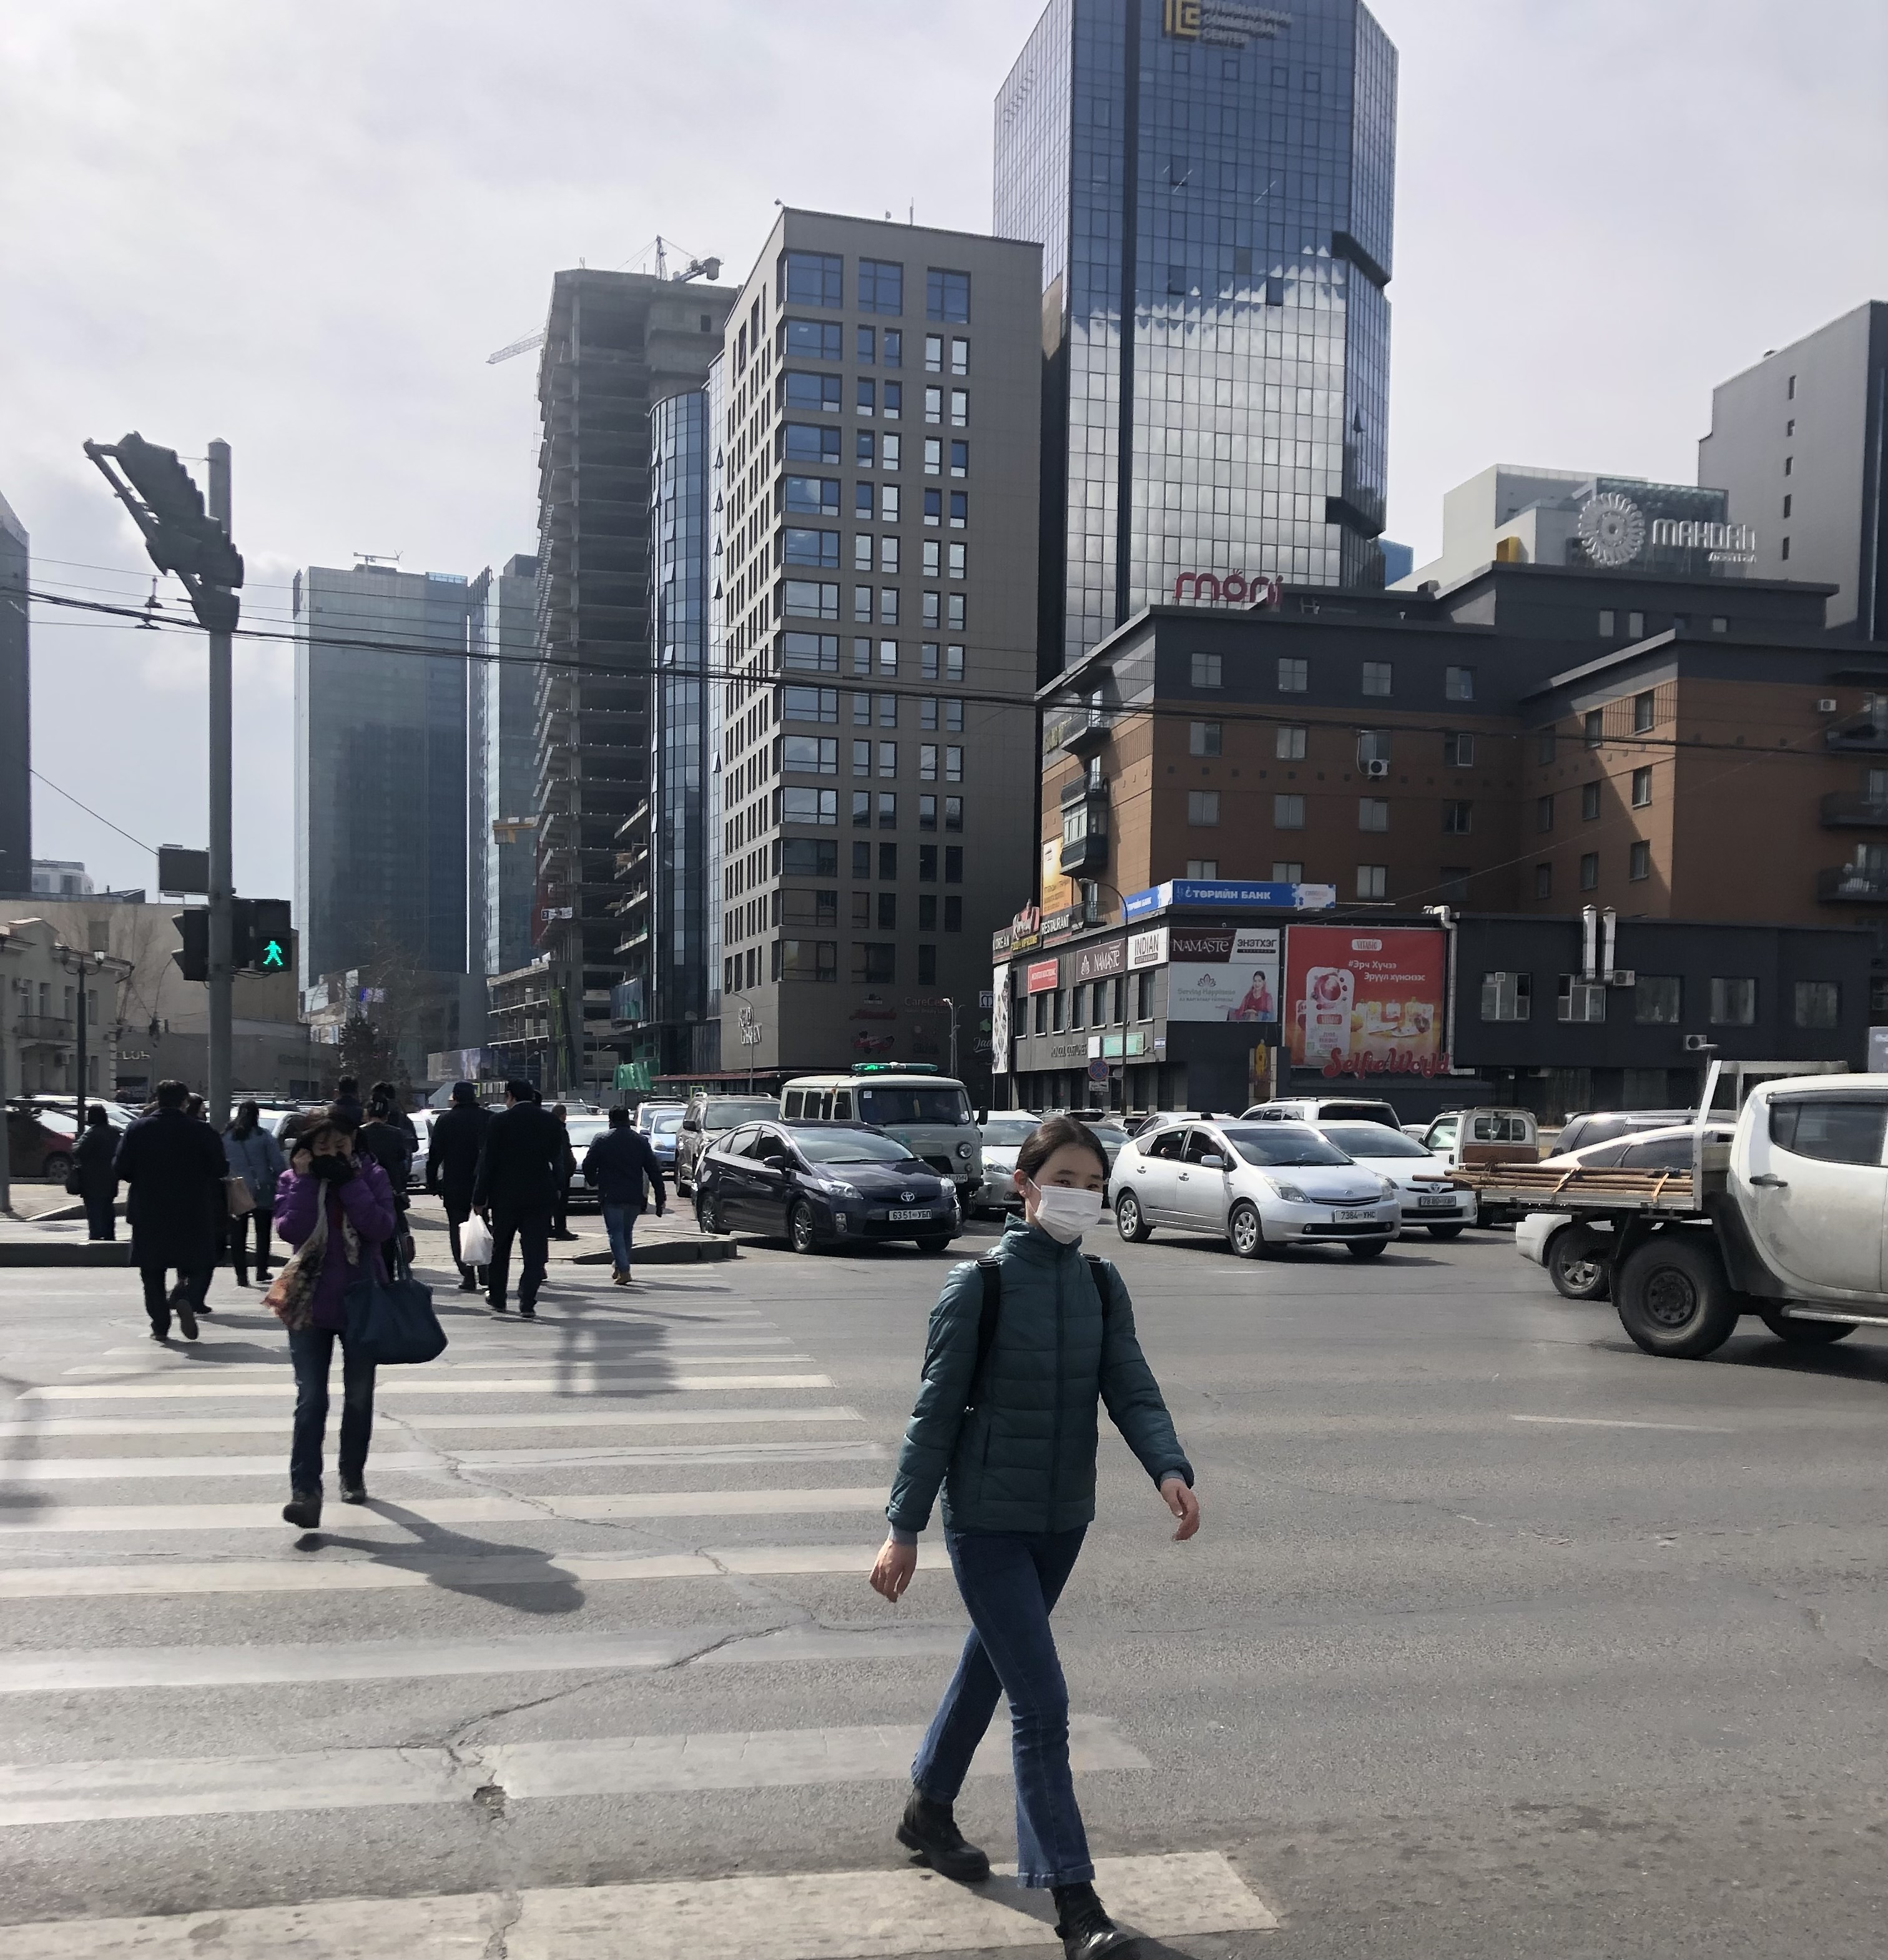
Half of the population live in the capital city Ulaanbaatar

Slide 9
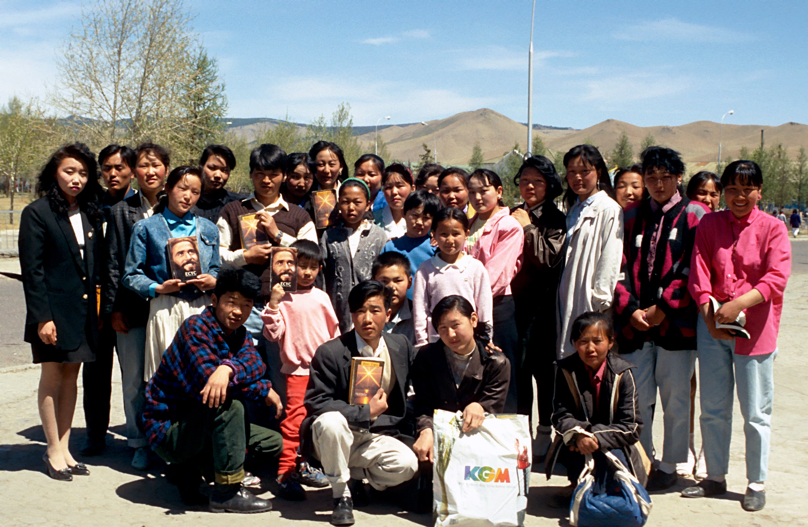
A group of first- generation Christians in 1993 with the then recently published New Testament

Slide 10
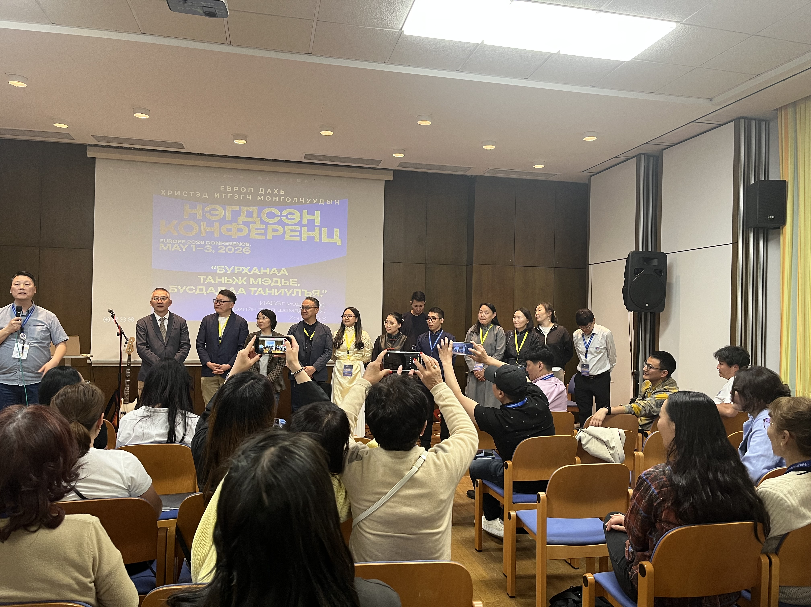
May 2026, the celebration of the first Mongolian translation of the Bible from the original languages by a team of Mongolians

Slide 11
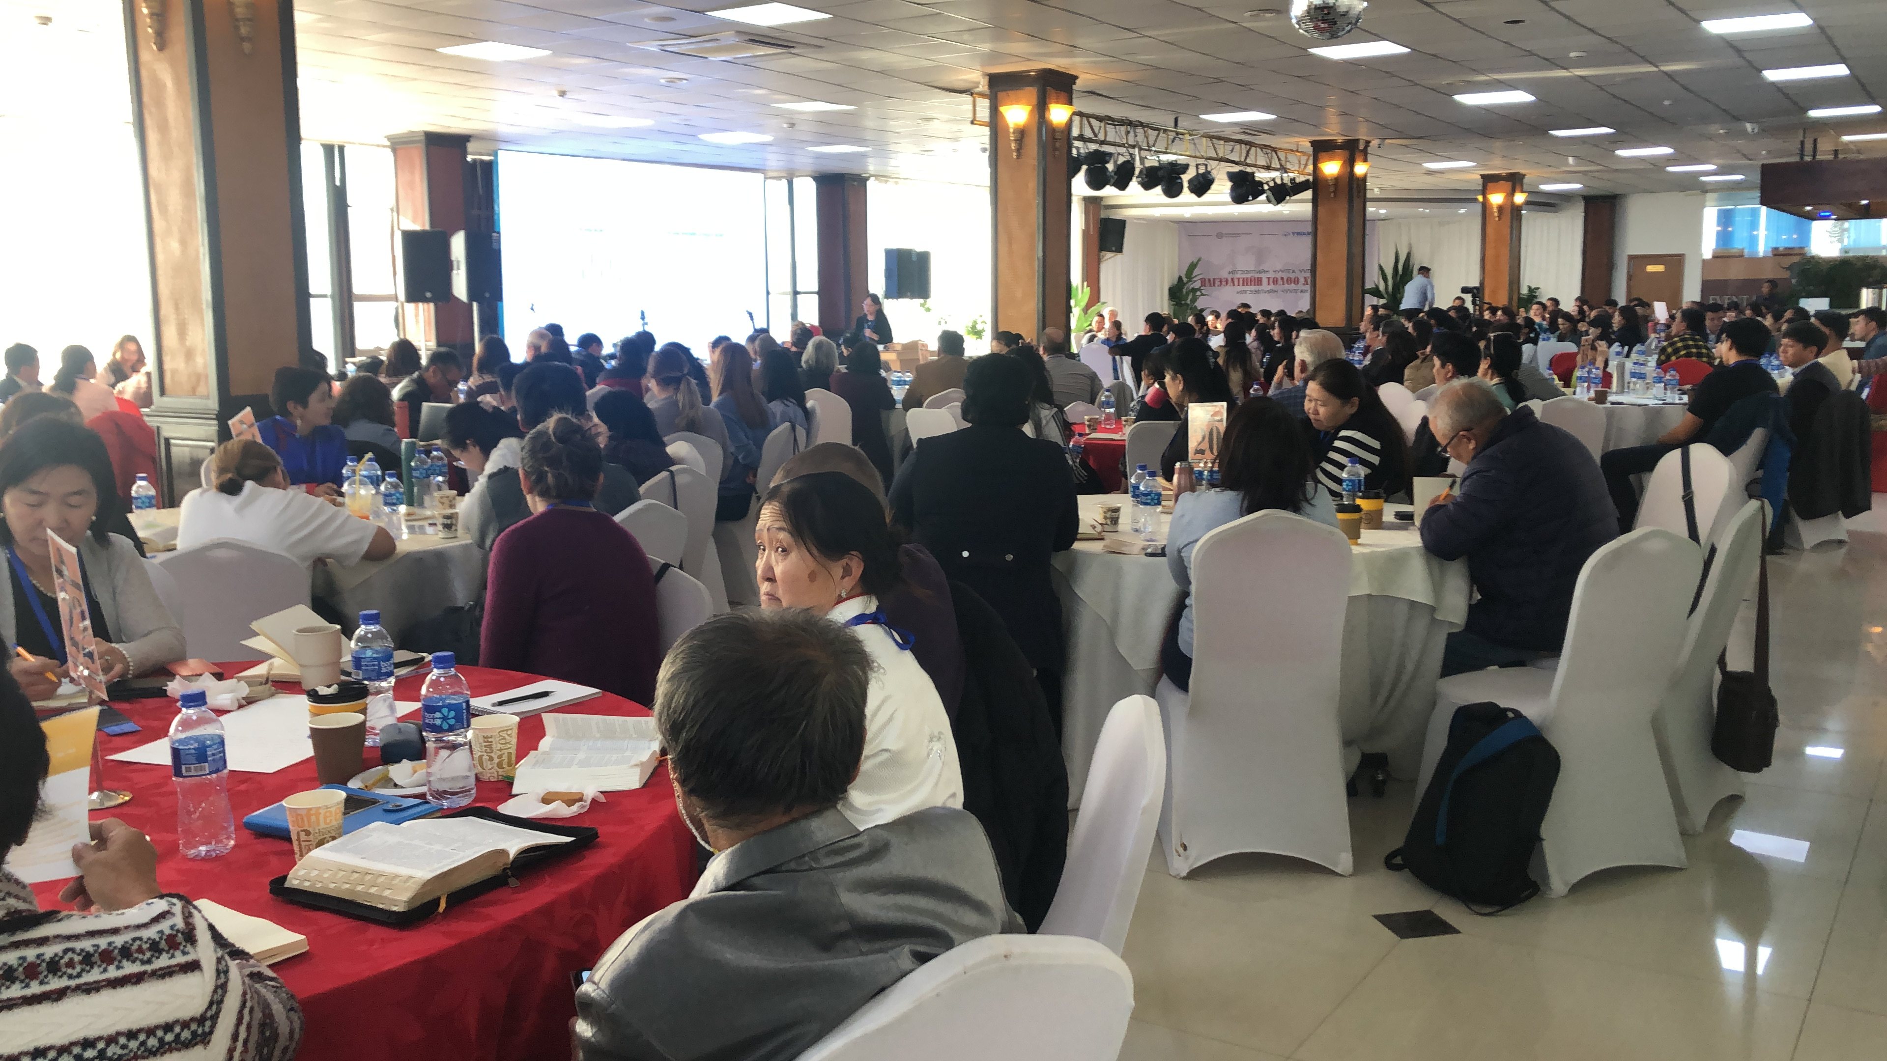
The first Mongolian-led Mission Conference as the church seeks to send missionaries

Slide 12
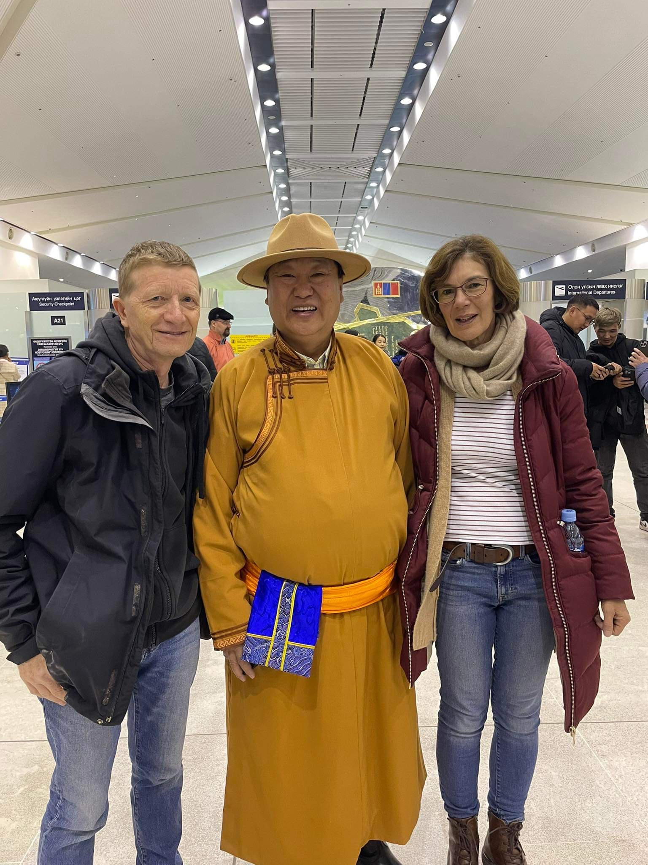
Mark and Gill Newham saying goodbye to a Mongolian friend

