Slide 1
Carrie

Slide 2
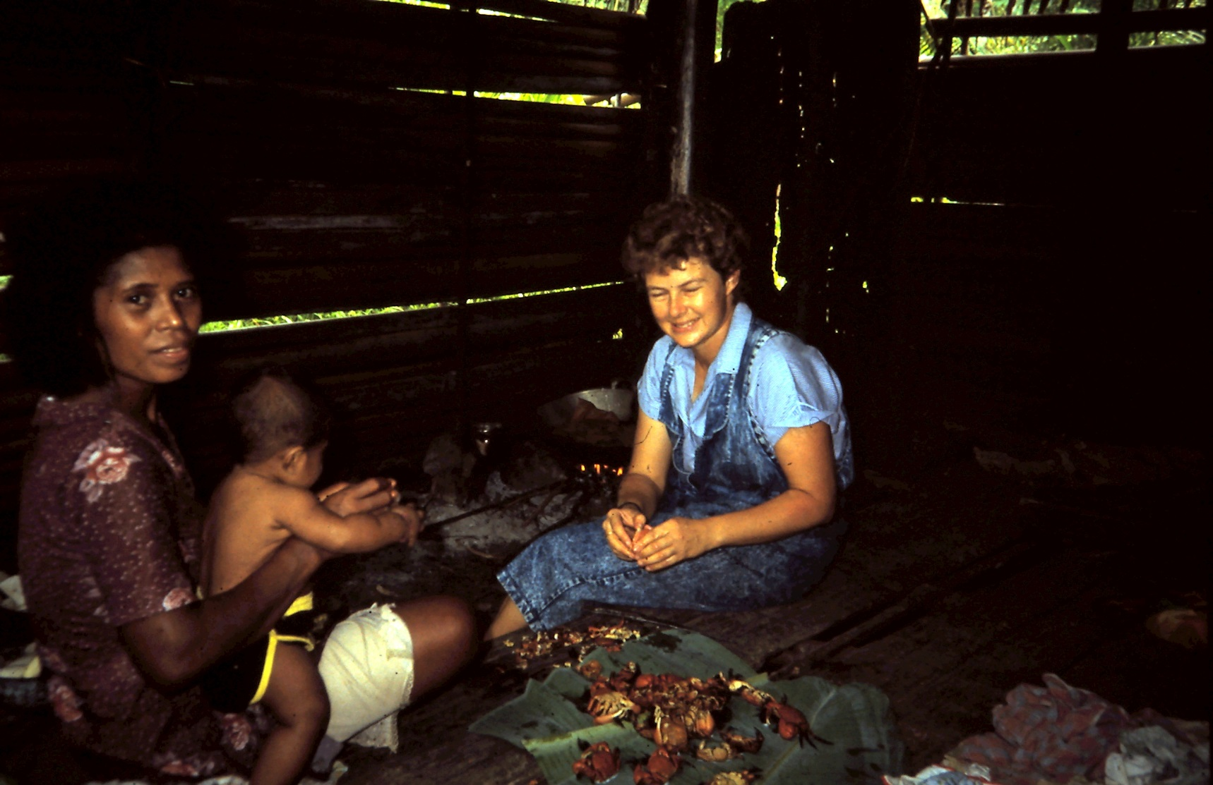
Learning the language

Slide 3
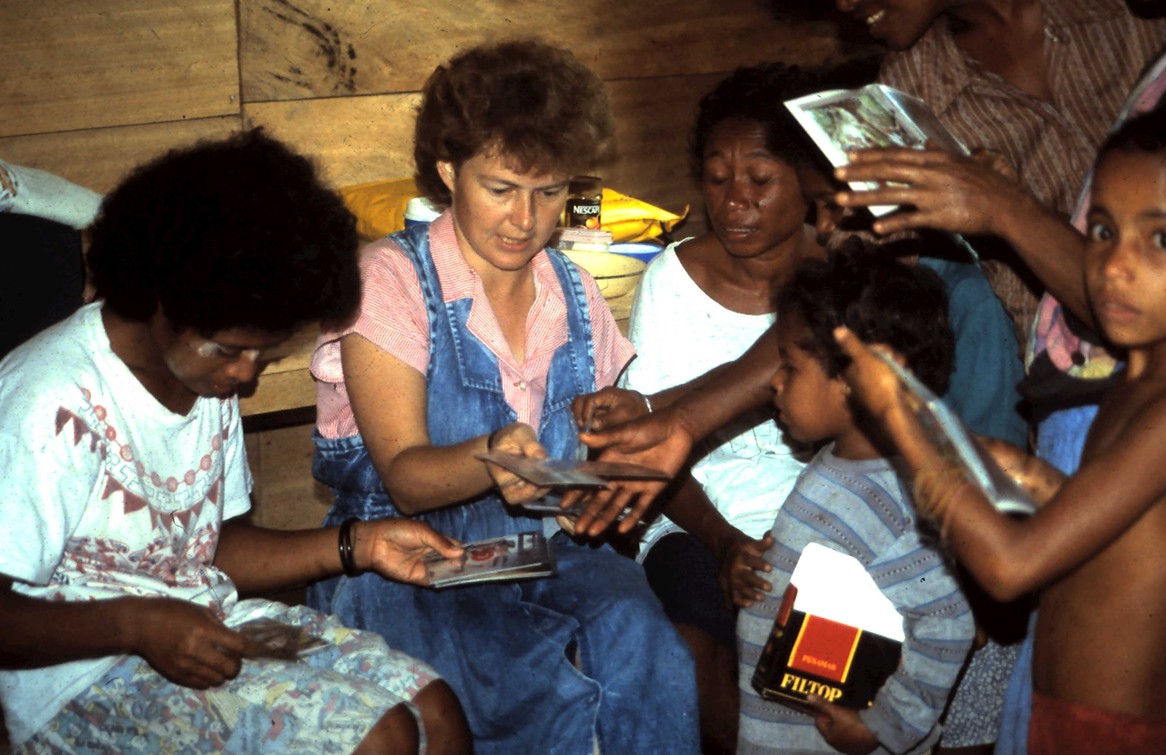
The children help Carrie to learn their language too….

Slide 4
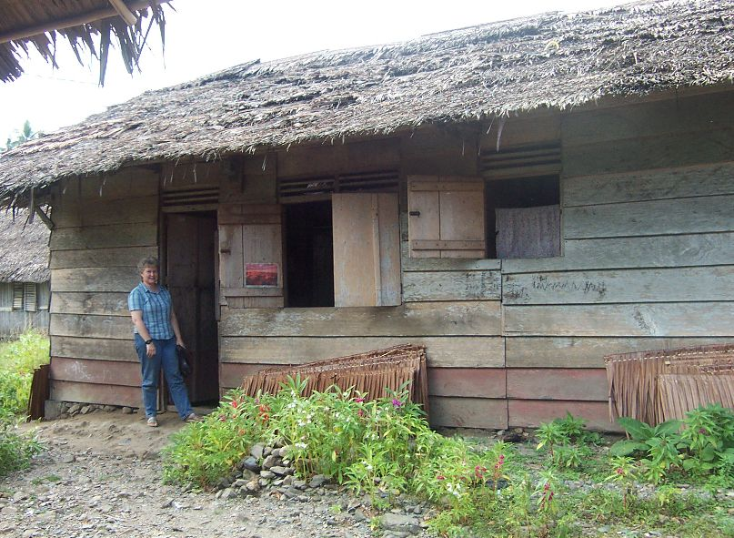
Carrie’s village hut

Slide 5
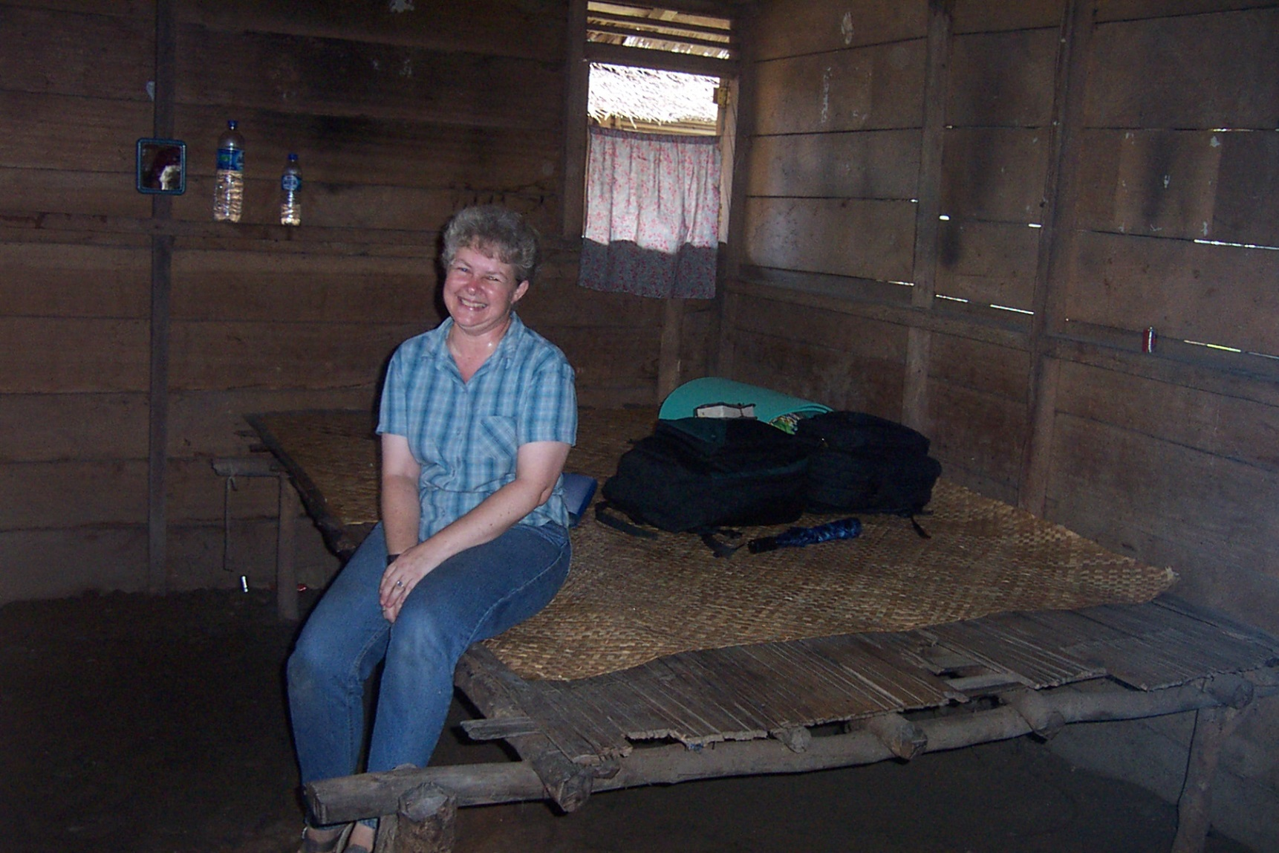
Carrie’s village bed

Slide 6
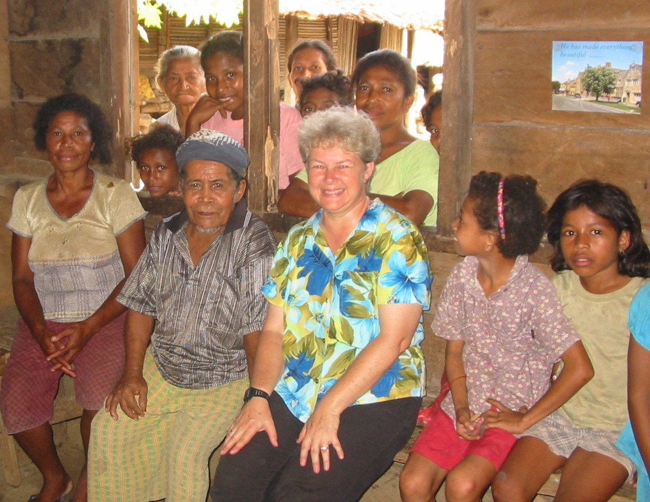
With friends inside Carrie’s village hut

Slide 7
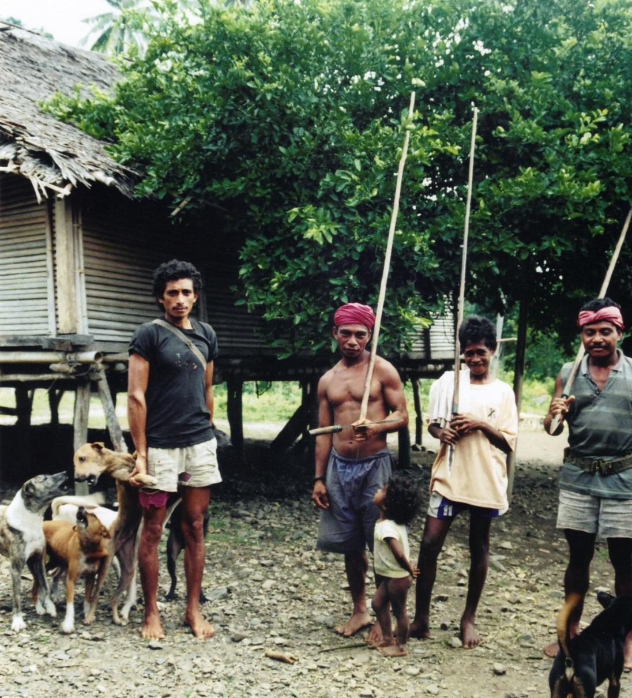
Time to go hunting for food..

Slide 8
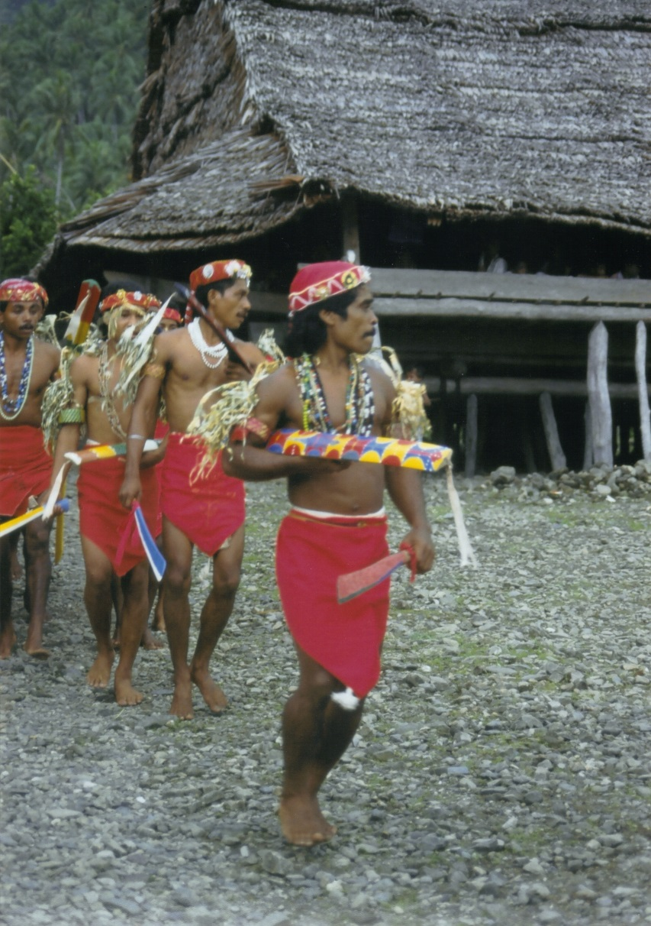
Time to celebrate..

Slide 9
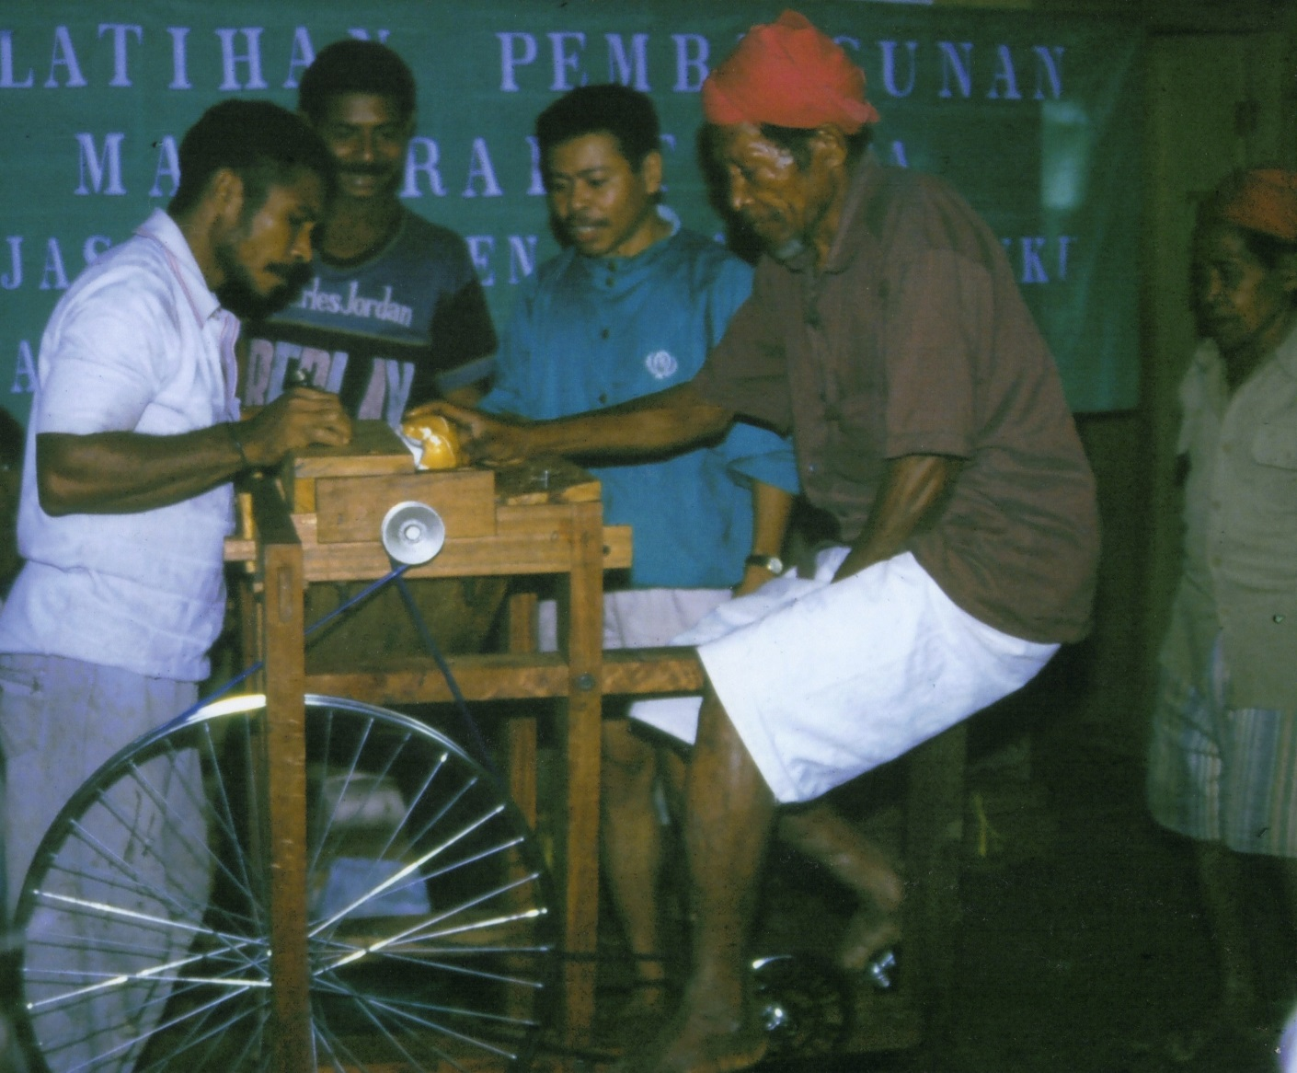
Learning a new trade
– a pedal coconut grater!

Slide 10
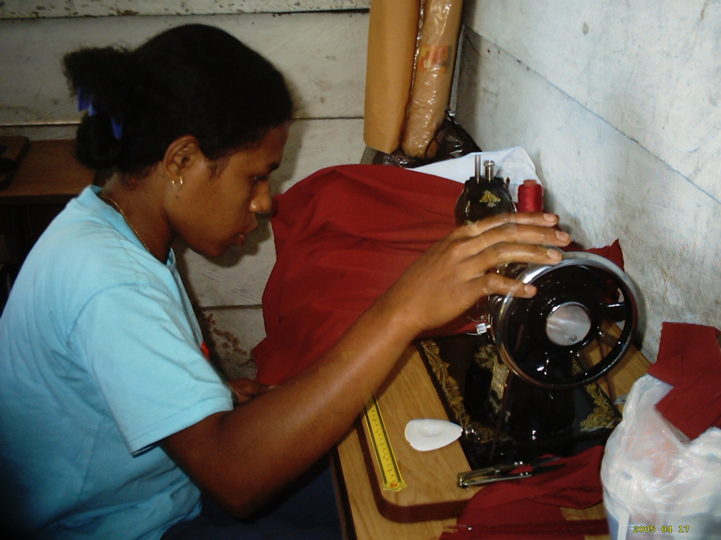
Learning to sew

Slide 11
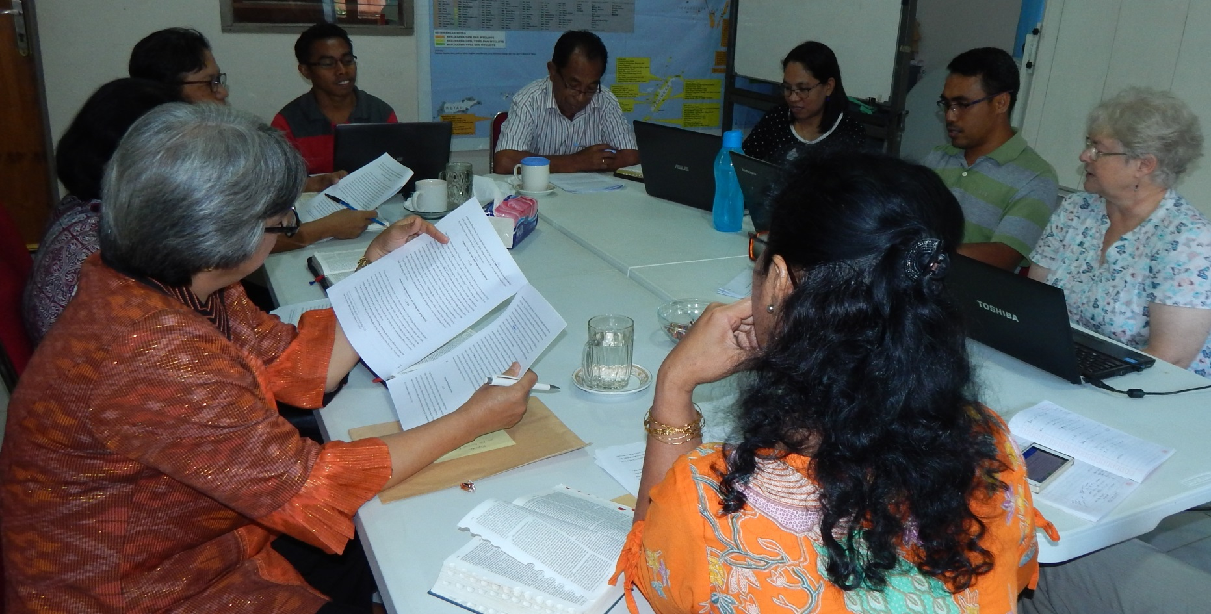
Translating the Bible into local language

Slide 12
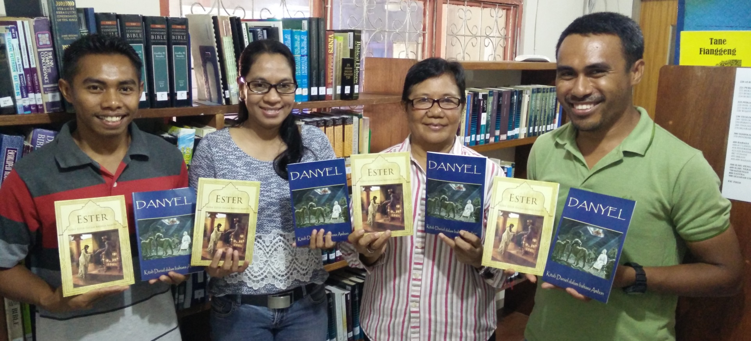
The books of Daniel and Esther are ready to read!

